Slide 1

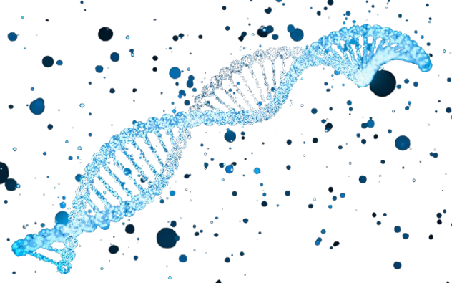

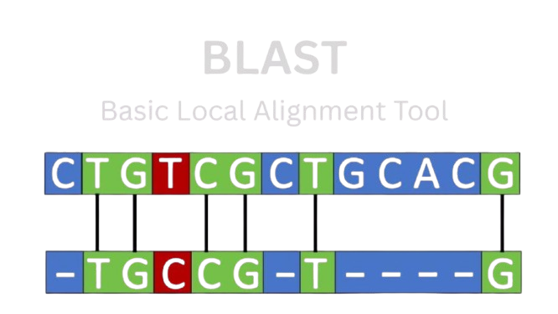
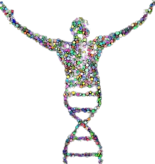
Sources
Altschul et al., 1990 (BLAST)
International Human Genome Sequencing Consortium, 2001/2004 (HGP)

Slide 2
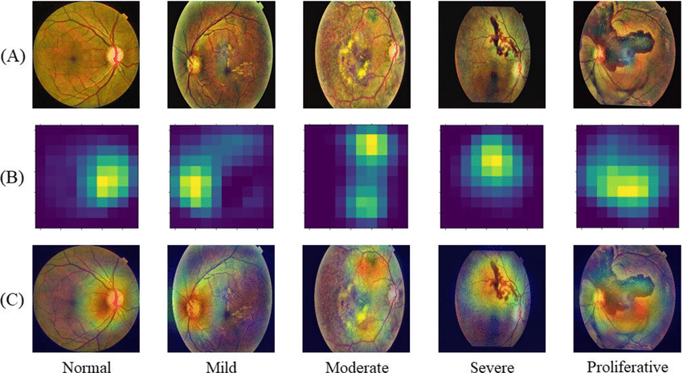

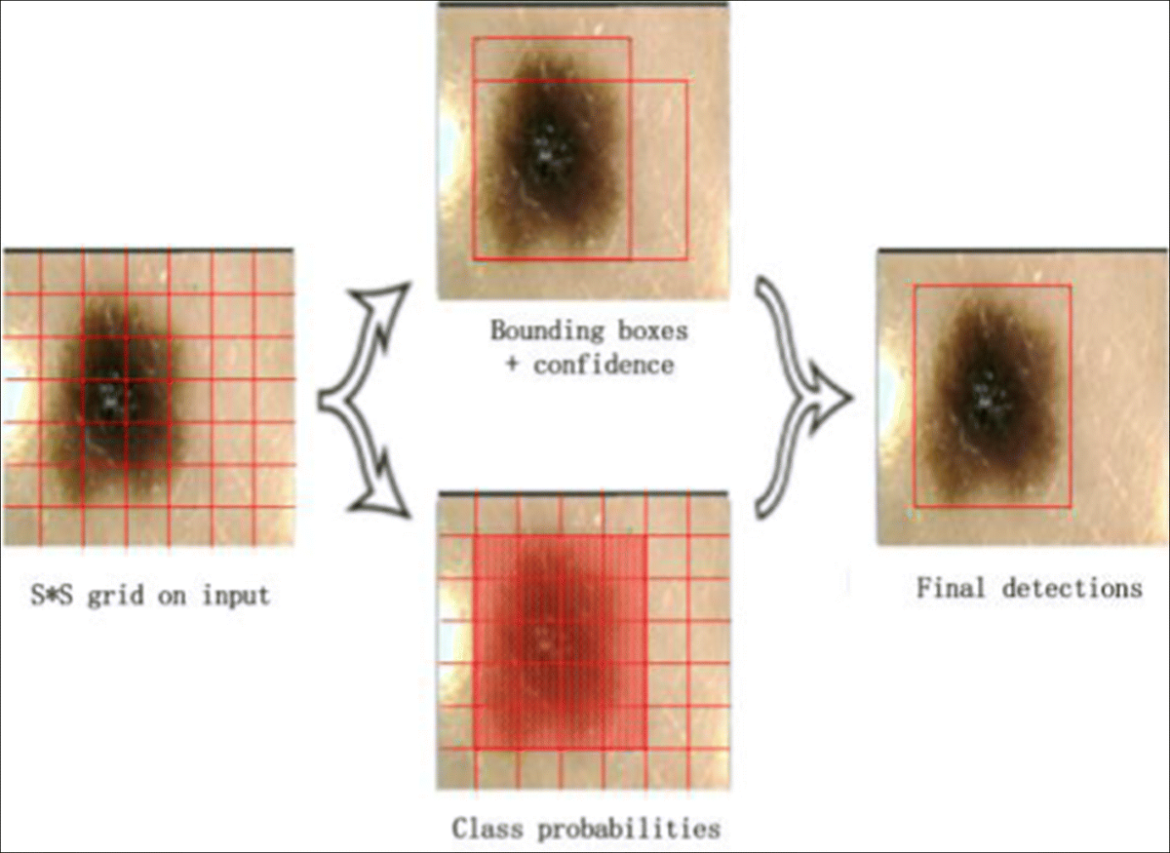
Disease Diagnosis
Source: Zhang et al., "Hinge attention network: A joint model for diabetic retinopathy severity grading," Applied Intelligence, 2022.
Sources
Gulshan et al., 2016 (Google DR)
Esteva et al., 2017 (Stanford skin cancer AI)
Ji et al., 2021 (DNABERT)
Source: Bian, X., Pan, H. and Zhang, K. et al. (2022) ‘Skin lesion image classification method based on extension theory and deep learning’, Multimedia Tools and Applications, 81, pp. 16389–16409.
Source: Quantpedia – “BERT model (Bidirectional Encoder Representations from Transformers)”, accessed 5 Oct 2025

Slide 3
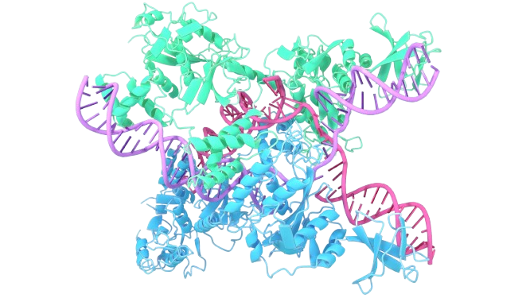
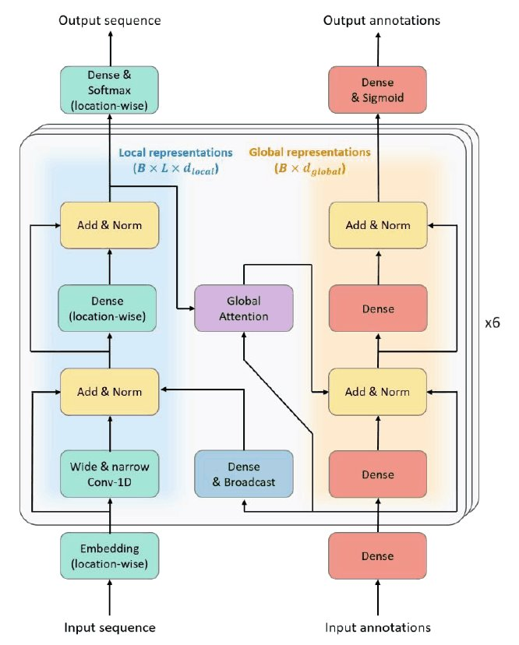



Drug discovery and personalised medicine
Sources
Jumper et al., 2021 (AlphaFold 2, Nature)
Brandes et al., 2022 (ProteinBERT)
Doench et al., 2016 (Azimuth, Nature Biotechnology)
Listgarten et al., 2018 (Elevation, Genome Biology)
Source: Brandes, N., Ofer, D., Peleg, Y., Rappoport, N. and Linial, M. (2022) ‘ProteinBERT: a universal deep-learning model of protein sequence and function’, Bioinformatics, 38(8), pp. 2102–2110.

